Slide 1


Attendance System Using Facial Recognition
Presented by :
Lakim Dahal (018-315)
Sunil Mandal (018-338)
Shankar Dangaura (018-334)

Slide 2

Introduction
“Attendance System Using Facial Recognition” is an web based application .
This application will be using face recognition technique for identifying, verifying and distinguishing employees .
It will recognize a person from a distance, without any contact or interaction with the person.
This system will involve registration of employees by taking their images and then taking them for setting Attendance.
It is easy to use and time convenient.

Slide 3

PROBLEM STATEMENT
Manual roll calling or signature against respective name is traditional form
Previous models are relatively slower in object identifying
Deep learning has been highly explored for computer vision applications.

Slide 4

OBJECTIVES
To maintain a record of their staff attendance
To identify and verify employees precisely
To eliminate manual marking of attendance
To make employees more diligent about attending office.

Slide 5
AIM
Increased accuracy.
Enhanced security
Increased efficiency
Better record-keeping

Slide 6
MOTIVATION
To create bridge between faculty and employees.
Reduce the risk of errors or fraud.
More convenient for employees.
Potentially save an organization money.

Slide 7
Scope
1. Hardware:
Cameras, scanners, and servers for capturing and processing face recognition data.
2. Software:
Face recognition software for identification and verification.
Additional software for attendance data management and analysis.
3. Maintenance:
Ongoing maintenance to ensure the proper functioning and accuracy of the attendance system.
4. Data Management:
Secure management and storage of the generated attendance data.

Slide 8

SYSTEM DESIGN AND TOOLS USED

Slide 9
System design and tools used
System Design is concerned with computer oriented design of the system. The attendance system using facial recognition has two types of user.
Admin
Employees

Slide 10
SYSTEM DESIGN
Admin Can :
Login
Register new employees to the system
Add employee photos to the training data set
Train the model
View attendance report of all employees.

Slide 11

SYSTEM DESIGN CONT…..
Employees Can:
Login
Mark his/her attendance (IN/OUT) by scanning their face
View attendance report of self

Slide 12
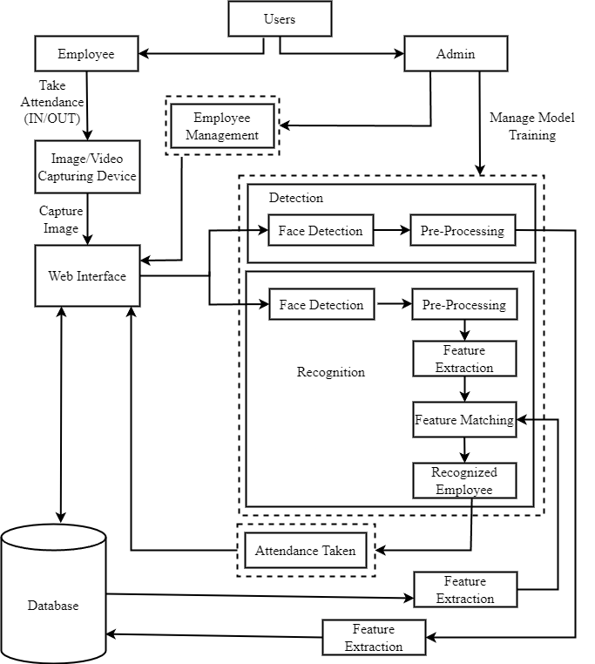
System Architecture

Slide 13
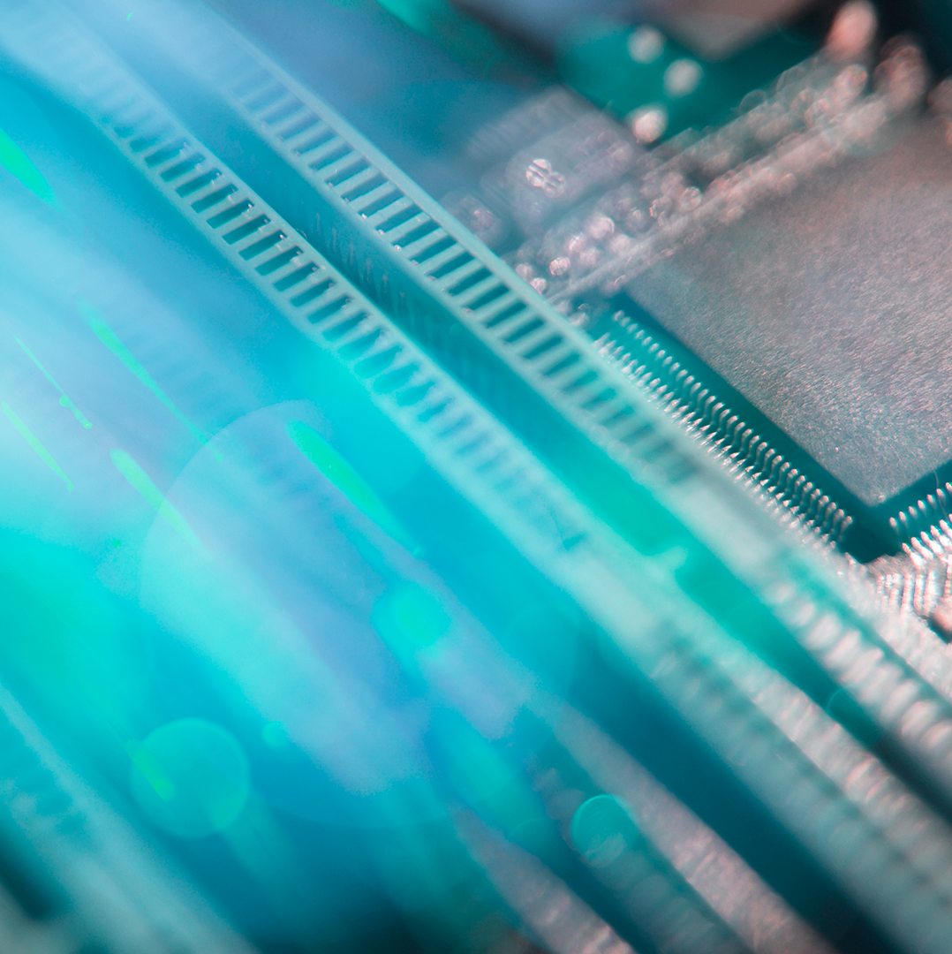
Experimental Tools And Setup 1. Django 2. OpenCV 3. Postgre SQL 4. VScode IDE

Slide 14
Implementation and discussion

Slide 15
Task Implemented
The basic design layout (web front-end part) and functionality of the project have been completed.
The web front-end can now communicate with the back-end and model server, enabling features such as signing in, register new employees, train data model.
Most of the back-end features, such as creating new employees, logging in, using authentication features, detection and recognition of the employees and updating the attendance.
The admin portal for managing the database and its information, including employees information, and attendance report.

Slide 16
Output Obtained
Registered employee and admin can login via login UI.
Admin can register new employees and train the datasets
Admin can generate the report based on date and employees name.
Employees can take attendance (IN/OUT) via UI.

Slide 17
Tasks to be Implemented
Employees time shifting.
Additional employee’s authentication features.
Attendance Report printing.
Data train for the individual employees separately and displaying on screen.

Slide 18
CONCLUSION
In this mid-term defence significant progress has been made in the development of an attendance system using facial recognition for employees. The project aims to provide a reliable, efficient, and secure solution for managing attendance records within an organization.
In conclusion, the mid-term progress of the attendance system using facial recognition is promising. The system's design and implementation have laid a solid foundation for achieving the project's objectives of accurate attendance management, improved efficiency, and enhanced security. Moving forward, further development and testing will be conducted to refine the system and address any potential challenges.

Slide 19
THANKS!
ANY QUESTIONS?

